Slide 1
High Level Design
(The One and Only)
Alexander Vukovic - Team Leader
April Fu - Secretary
Oscar Vidal Rubio - Customer Liaison
Caroline Kim - Integration Liaison
Katie Caruso - Project Manager
Notes:
Good afternoon. We are the one and only my name is --- and this is --- and we will be presenting the high level design of the database.

Slide 2
Summary
Database
Design Pattern
Classes:
User Class
Post Class
Notes:
Just a quick summary. We will be going through which database we will be using, the design pattern, and just a quick overview of two of the classes that we will be using.

Slide 3

Database - MySQL
Provide a wrapper API
https://en.wikipedia.org/wiki/MySQL
Notes:
For the database we have decided to go with MySQL. We will provide a wrapper API class in adapter design pattern so that calls can be made from the web servers to the database without knowing how the exact code is implemented.

Slide 4
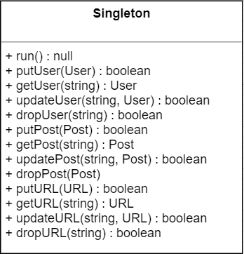
Singleton Pattern
Database is always “open”
Needs to be repeatedly accessed
Need to modify quickly
Needs to be efficient
Notes:
For our design pattern we have decided to use the singleton pattern. Using this design pattern will ensure that there is only one single instance of the class, when accessed from different parts of the code which will also enables us to ensure that variables cannot be easily overwritten which could cause problems and even crash the program.
It is important to note that the database will always be open and needs to be repeatedly accessed. This means that it needs to be modified quickly and efficiently . We can think of this approach as a bottleneck in which all of the requests will be logged and bottlenecked through this one class.

Slide 5
Classes:
User
User Class
Email | IDKey | name | password | type
carolinekim@gmail.com | ckim1 | Caroline Kim | kim97caroline | member
dfisher@umass.edu | dfisher | David Fisher | df123*45 | owner
janedoe@gmail.com | jane13 | Jane Doe | jd123 | member
jjyoon@umass.edu | jjyoon | Joshua Yoon | rkskek078! | moderator
michelle68@sva.edu | msmith | Michelle Smith | M*sm1th | admin
Owner
Member
Admin
Moderator
Notes:
This leads us to the User class. This diagram dictates the hierarchy of the User class. As you can see there are four types of users: the Owner, Admins, Moderators, and Members. We will go through the User class in the following slide.

Slide 6
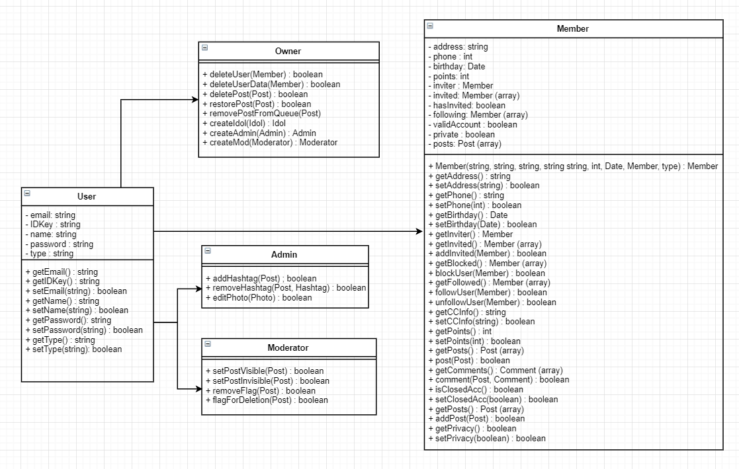
User
User data members:
Email
IDKey
Name
Password
Type
Notes:
The User class is pretty simple. It will have five data members that will be private. The five data attributes are: the email, the id of the user, the name of the user, the password and the type of user. The type data member will be the variable that determines whether you are the owner, an admin, a moderator, or just a regular member. As always there will be setters and getters which will directly modify these variables.

Slide 7
Classes:
Post Class
Posts
type | time | user | comments | visible | explicit | id
status | 2019-03-10 15:00:04 | ckim1 | 2 | 1 | 0 | 1
comment | 2019-03-10 19:23:56 | jane13 | null | 1 | 0 | 2
photo | 2019-03-12 04:38:11 | jane13 | 5 | 1 | 1 | 3
status | 2019-03-12 17:08:43 | jane13 | null | 0 | 0 | 4
comment | 2019-03-12 18:10:01 | ckim1 | 6 | 1 | 0 | 5
hashtag | 2019-03-12 19:00:35 | msmith | null | 0 | 0 | 6
Table mockup
Hashtag
Status
Photo
Comment
Notes:
This leads us to the Post class. This diagram dictates the hierarchy of the Post class. As you can see there are two types of posts: a hashtag and a status. But there are also two types of statuses: a photo and a comment. And again we will go through the Post class in the following slide.

Slide 8
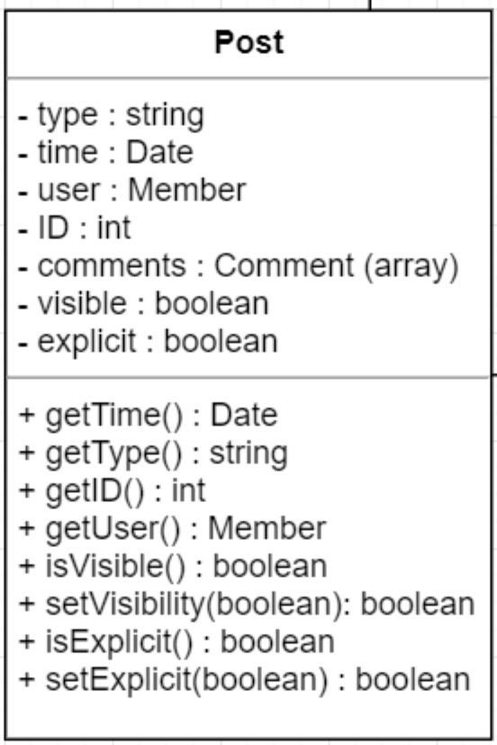
Post
Post data members:
Type
Time
User
ID
Comments
Visible
Explicit
Notes:
The Post class will have the following private variables: the type, the time the content was posted, the user that posted it, the ID of the post, any comments that were made on the post, the visibility of the post, and whether or not the content is explicit. The type of post will again determine if post is a hashtag, photo, or comment. And again there are setters and getters for each of the variables.

Slide 9
Conclusion
Database
Design Pattern
Classes:
User Class
Post Class
Notes:
In conclusion we have gone through the database that we will use which is MySQL, the design pattern which will be the singleton pattern, and the user and post classes.

Slide 10
Questions?

Slide 11
Thank You!

